Slide 1
Proposal Idea: Creation of Residential Lots & Barn Event Venue for 31807 -60th St., Salem, WI 53168

Slide 2
Table of Contents
Mission
Potential Business Name & Hours of Operation
Proposal for Residential Lots, Exits/Entrances, Parking Areas
Varying Views of Barn and Property
Occupant Load Calculations
Business Plan
Potential Events

Slide 3
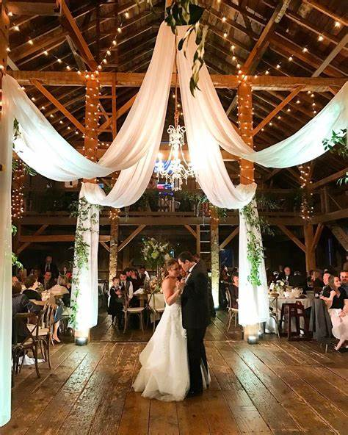
Mission: Provide a safe, friendly wedding/event venue for folks looking for a rustic, unique, rural, and personal experience

Slide 4
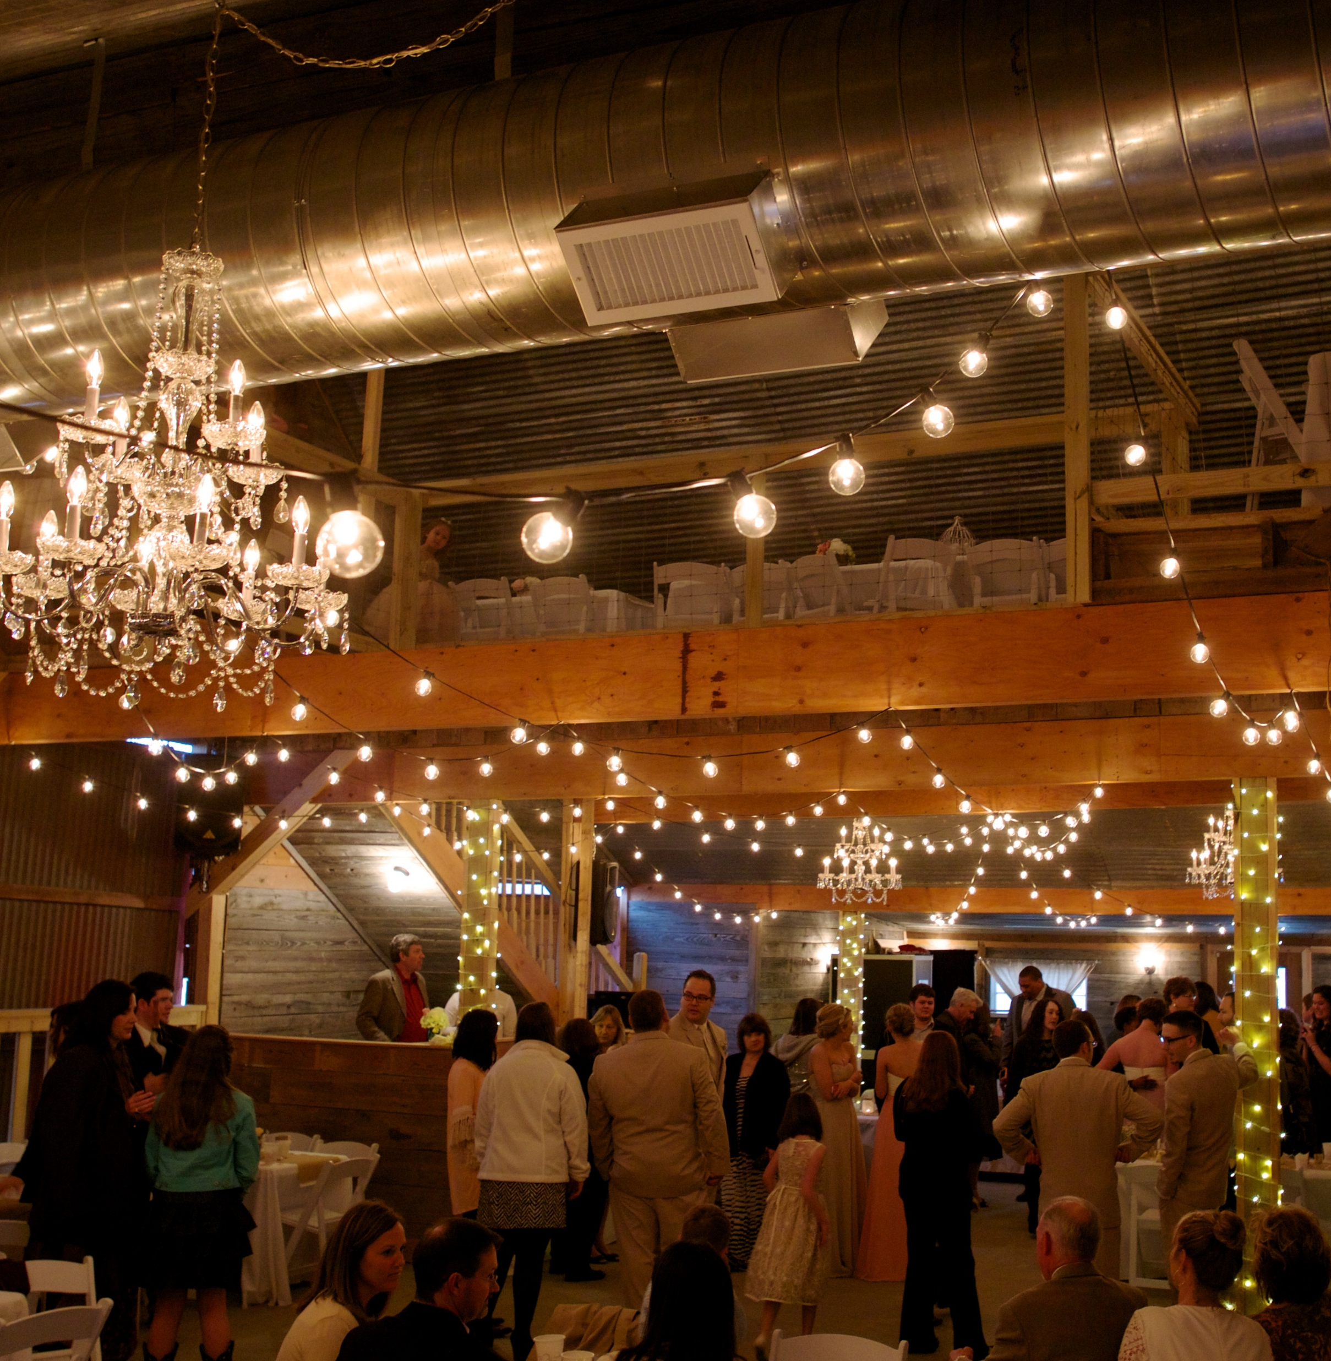
Audience: Any engaged couple, persons with birthdays, anniversaries, expecting a baby, having a corporate job, needing a venue to celebrate

Slide 5
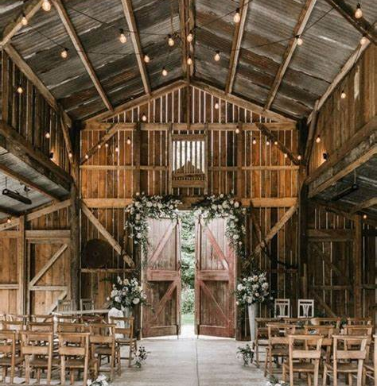
Marketing: Website, social media, partnering with local establishments, creating preferred vendors, tours and bridal shows
Notes:
Local establishments who serve food and are interested in catering, florists, bakeries, wedding planners, entertainers, photographers, rentals, spas/salons, distributors, transportation, etc.

Slide 6
Paved with Good Intentions Wedding/Event Venue -less than100 people per area -2 areas for events -1 operate May-Oct -1 operate Jan-Dec -Hours of operation: Th-Su Noon- 11:30 PM Mon-Wed by appt
Paved with Good Intentions

Slide 7
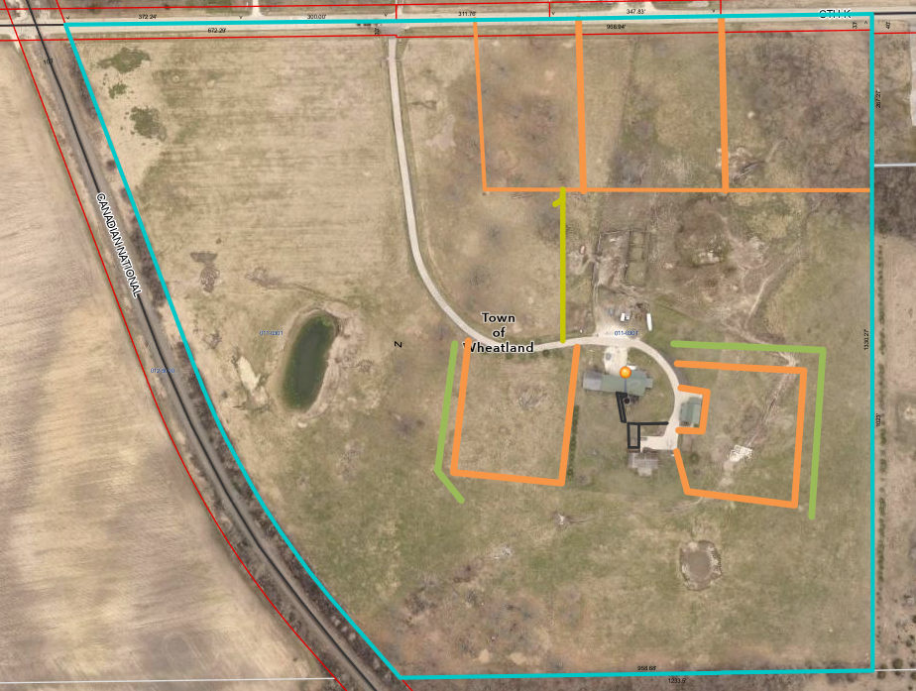
Proposal Residential Lots & Parking for Venue
Lot 3 1.6 acres
Lot 2 2.25 acres
Lot 1 2.5 acres
Berm and greenery
300 ft
Berm and greenery
Parking Lot
Back-up Parking Lot
Handicap parking

Slide 8
Future Fire Escape or Exit if Needed
Potential
Fire Escape

Slide 9
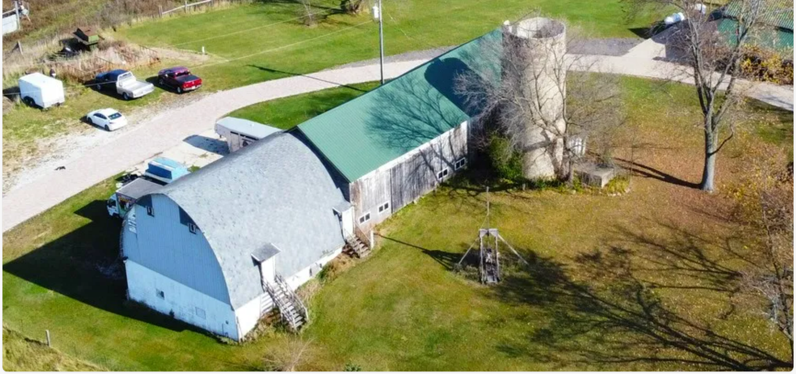
Proposed Entrances at Ground Level
Retaining wall to fill in and have this entrance at ground level

Slide 10
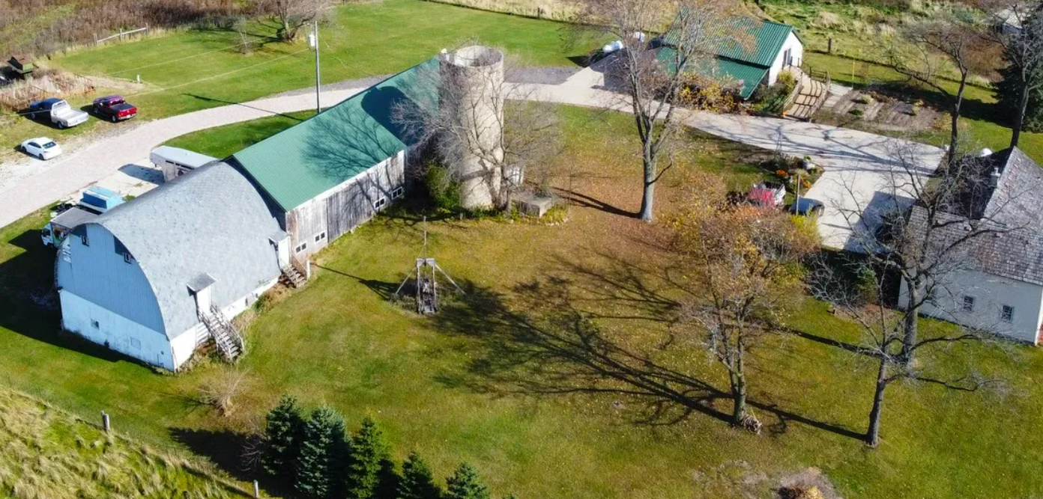
Proposed Entrances With Handicap Parking
Ground level entrance & paved walkway
Proposed handicap paved parking
Future French doors to balcony (Section C)
Retaining wall to fill in for ground level entrance
Future Balcony with railing and ADA ramp
Retaining wall to fill in and have this entrance at ground level

Slide 11
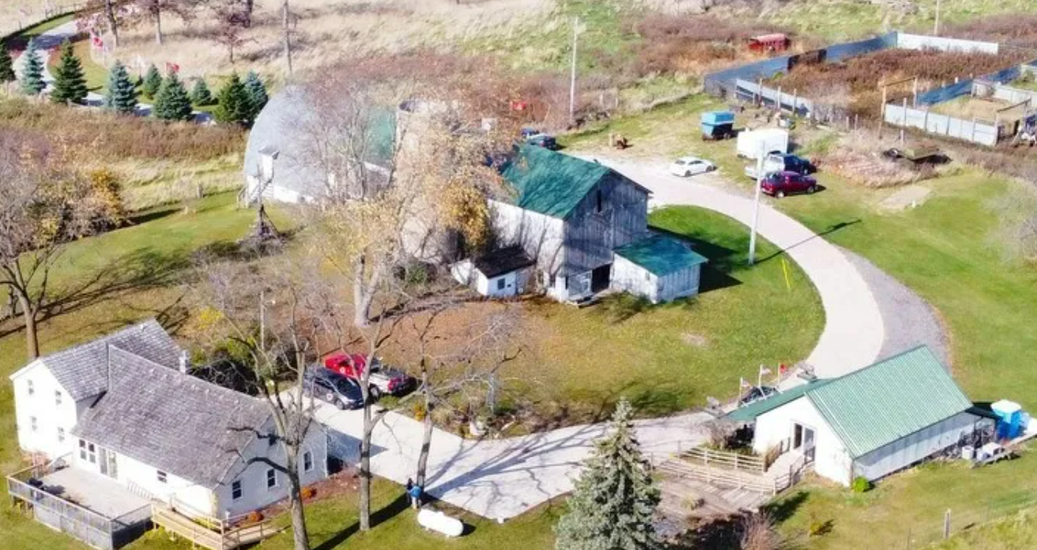
Proposed Exit & Balcony
Exit & Balcony

Slide 12
Diagram of Barn
New door at ground level
This is not drawn to any scale, just for description; dimensions are estimates taken from the interactive map and will need to be confirmed
Existing doorways in blue would be ground level (Section B & C will require fill to build up ground to meet exits)
Green door may go away with the added doors to the balcony
Red line = maybe a required firewalls? Section C will not require fire suppression, so not sure if this is needed
Future Balconies on each end of the barn with railings and ADA access points if needed

Slide 13
Occupant Load
Function of Space | Occupant Load Factor (sq ft) | Number of persons permitted in 2720 sq ft barn (A+B) | Number of persons permitted in 1480 sq ft section (C)
Concentrated chairs only | 7 | 389 | 211
Standing space | 5 | 544 | 296
Unconcentrated tables & chairs | 15 | 181 | 99
Occupant Load Factor is based on values from section 1004 Occupant Load from State code provided by Building Inspector of Kenosha County
Sections A+B = 32’ X 85’ Barn area, would remain rustic barn interior operate May-Oct
Based on calculations looks like we would be A-2 for this section??
Section C would be a 4 seasons area that would be climate controlled for future venues operating Jan-Dec

Slide 14
Business Plan/Goals Timeline- 2024
Purchase Land
Re-zone for 3 Residential Lots (1 lot – 2.5 ac, 2- 2.25 ac, 3 – 1.6 ac)
Re-zone from AG1 to AG2 if needed (depending on actual acreage of the property) there maybe 35 acres left to leave in AG1
File for conditional use permit for wedding venue and B & B
File for liquor license or Beer and Wine Licenses
Repairs to Section C roof
Make modifications to Section A&B to meet state, county, and town codes – firewall, entrance/exits, electric – lighting exit signs etc., plumbing (add bathrooms), fire suppression, flooring, bar, parking, walkways, mound system, balcony, etc. (non-climate control operating May-Oct)
Website and social media set up – Attend Bridal Shows
Notes:
Meeting state, county, & town

Slide 15
Business Plan/Goals Timeline 2025-2027
Create outside spaces for ceremonies around the silo & pond (Spring 2025)
Modify store for Bride/Groom prep areas, add water & bathrooms
Set up B&B for accessibility for Bride and Grooms
Inspections
Open Section A&B for events Spring ~ May of 2025
Work on Section C with revenue from A&B (repeat everything from Section A minus the mound, parking and fire supression), plus insulation and modern day finishes with a rustic feel, & climate controls.
Update Website with additional venue with pictures, etc.
Inspections
Open Section C for events – Early 2026 (operating Jan-Dec)

Slide 16
Potential Events
Weddings
Bridal and baby showers
Rehearsal dinners
Corporate Events
Birthday and Anniversary Parties
Reunions

Slide 17
Thank you
Georgia Tenhagen
262-498-6186
gatenhagen85@gmail.com

